Slide 1
“Predicting whether or not people tend to opt for a Loan over Discounted Rates” IPBA4 GROUP4
Chandrika Mazhar Swarna
Saurabh Sanchit Kalyan

Slide 2
Business Problem:
A group of customers were given an offer in person that they can get a loan at discounted rate and processing fee will be waived off. A pilot campaign was conducted to get response from customers whether they are interested in taking out a loan or not. Response was recorded and data was collected. Based on data given we need to:

Slide 3
Business Problem Contd
Build a model to predict whether customers will be interested in taking out a loan or not.
Identifying features which are most important
In case of black box models e.g. Random forest use SHAP, LIME to figure out features affecting the target variable.
Approaching a customer has costs involved with it, hence find the profitable segments so that more customized marketing can be done.
Model will be needed on a monthly basis as this data gets updated each month.

Slide 4
Business Problem Contd
Attributes given in DataSet;
Customer_id
Age
Gender
Balance
Occupation
No of Credit transaction
SCR
Holding period

Slide 5
Approach Formulation
In order to

Slide 6
Data Preparation
1. Data Preparation
Importing important libraries
Reading data –
Checked data types. Gender and Occupation are categorical variables stored as object type. Balance is stored as float type. Converted float type to integer type for Balance variable.
Checked null value and found there are no null values in the dataset. Null value treatment is not required.

Slide 7
Exploratory Data Analysis
2. Exploratory Data Analysis –
Correlation-
TARGET showed maximum correlation w.r.to No of Credit transaction among other variables. So remaining correlations have to be visualized in order to understand if there's any sort of trend in data.
Pair Plot –
People who tend to opt for loan have less BALANCE w.r.to people not interested to take loan.
People having higher BALANCE tend to be in between 35-50 years of AGE.
People having less BALANCE tend to show more interest towards loans i.e. higher SCR values.
People having less BALANCE tend to have higher No of Credit transactions opt for loans.
People having less BALANCE have higher HOLDING PERIOD who opt for loans.

Slide 8
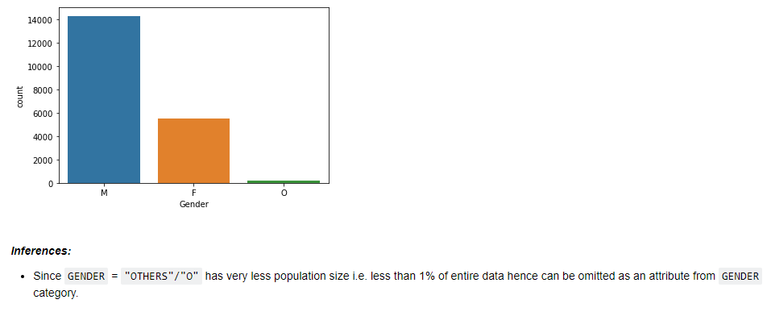
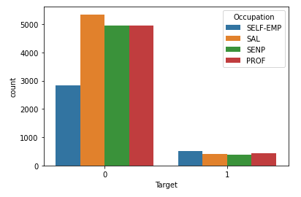
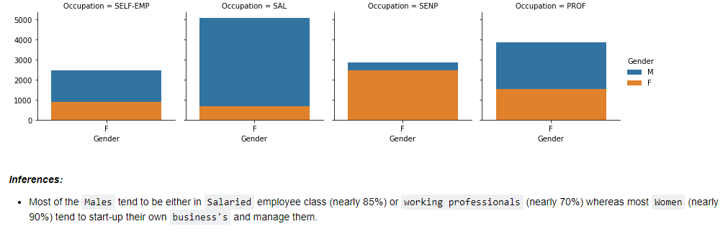

Slide 9
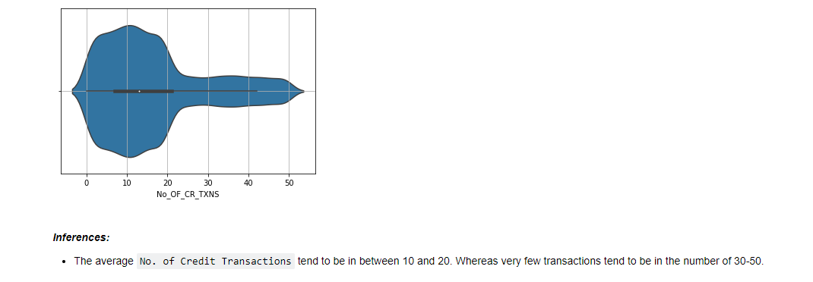
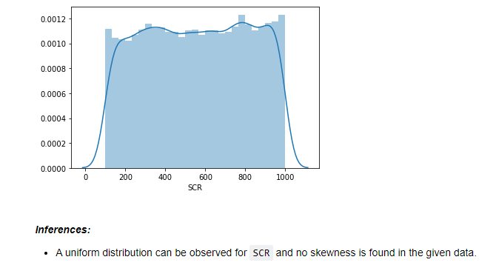

Slide 10
3. Model Building -
Created training data and test data by splitting the data.
Developed model using different Machine Learning algorithms like Decision Tree Classifier, SVM Classifier, KNN Classifier, Random Forest Classifier, Logistic Regression.
Developed model for original, undersampling and oversampling data and compared results.
Created undersampled data using nearmiss() and oversampled data using SMOTE().
Found out important features from Random Forest Classifier as: SCR, Balance, No. of Credit Transactions and Holding Period.

Slide 11
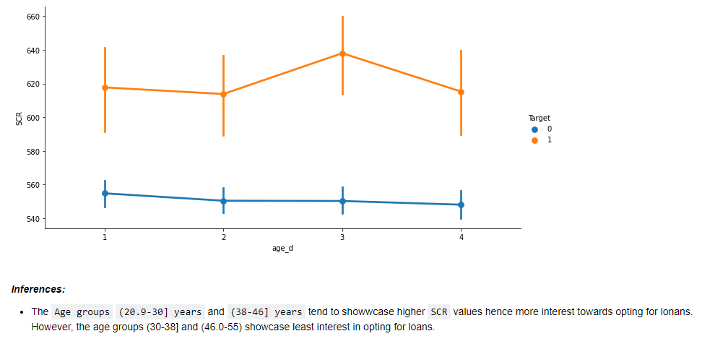

Slide 12
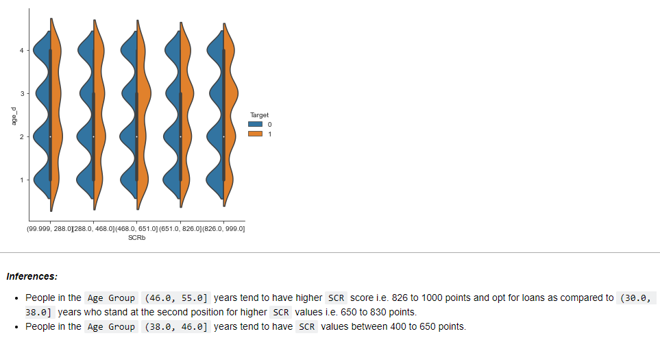

Slide 13
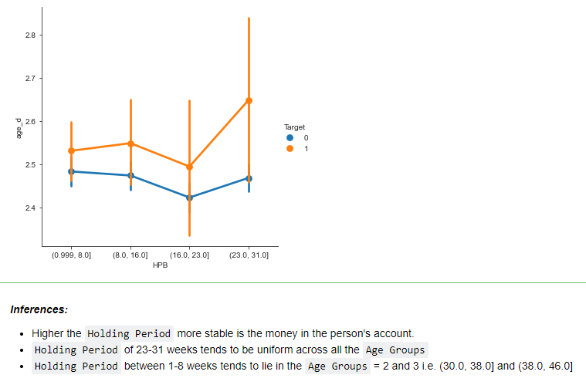

Slide 14
4. Observations
B. Post Bucketing Visualization
Observations on Bucketed Data
People who tend to opt for loan have less Balance w.r.to people not buying loan.
People having higher Balance tend to be in between 35-50 years of Age.
People having less Balance tend to show more interest towards loans i.e. higher SCR values.
People having less Balance tend to have higher No of Credit Transactions opt for loans.
People having less Balance have higher Holding Period who opt for loans.

Slide 15
Model Evaluation
ML Algorithm | Sensitivity Percent% | Comments
DecisionTreeClassifier - Original Data | 10.9 | Not Considering
DecisionTreeClassifier - UnderSampled Data | 9.84 | Not Considering
DecisionTreeClassifier - OverSampled Data | 19.6 | Not Considering
KNN Classifier - Original Data | 17.2 | Not Considering
KNN Classifier - Undersampled Data | 8.6 | Not Considering
KNN Classifier - Oversampled Data | 17.2 | Not Considering
Random Forest Classifier - Original Data | 18.4 | Not Considering
RandomForest Classifier - Oversampled Data | 25.0 | Considering
Logistic Regression - Original Data | 25.0 | Considering
Logistic Regression - Undersampled Data | 16.4 | Not Considering
Logistic Regression - Oversampled Data | 20.8 | Considering
RandomForest Classifier - Undersampled Data | 11.4 | Not Considering

Slide 16
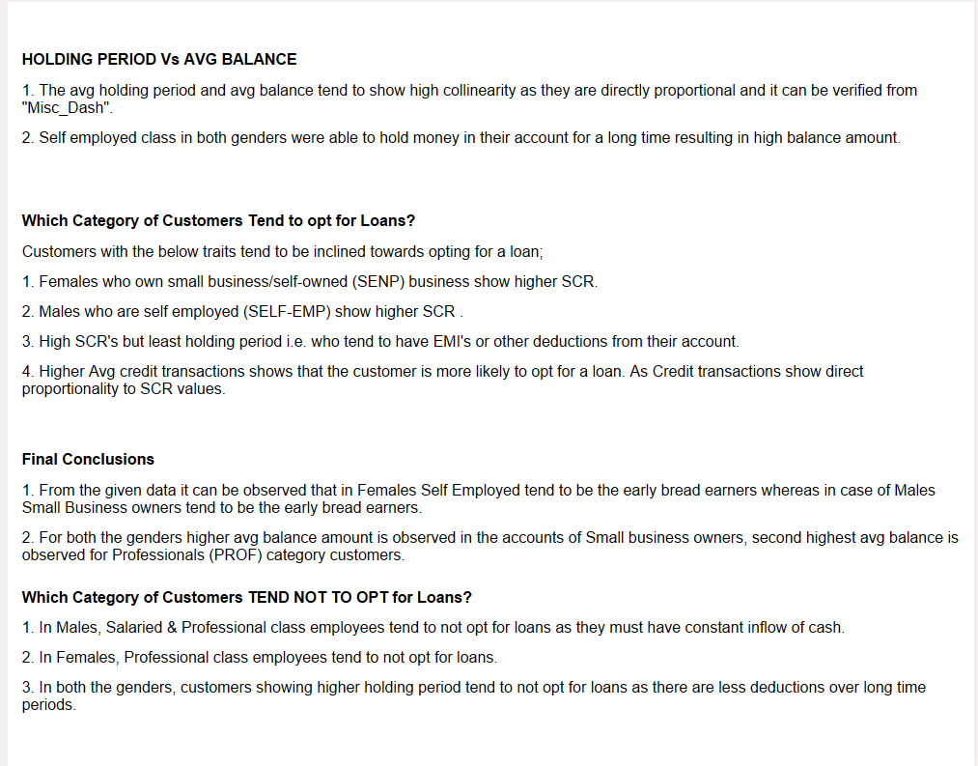
Conclusion

